Slide 1
🚦 AI-Based Traffic Congestion Prediction & Optimization System
"Predict. Prevent. Optimize."
TEAM NAME:- ''Code Blooded''
EVENT:- HACKANOVA 2026
TEAM NUMBER:- 33

Slide 2
The Problem:- Peak-hour gridlocks, Infrastructure bottlenecks, No advance congestion prediction
Result: Time loss. Fuel waste. Pollution.
CORE IDEA
An AI-powered smart traffic system that predicts congestion and dynamically adjusts signal timings to optimize traffic flow in real timeReal-time blood stock tracking
INNOVATION & UNIQUENESS
A predictive, AI-driven adaptive signal system that dynamically optimizes traffic flow instead of relying on fixed timers.
Uses AI to analyze real-time and historical traffic data to predict congestion and automatically adjust signal timings
HOW IT WORKS

Slide 3
TARGET USERS
Traffic Police Department
Monitor congestion in real time
City Traffic Control Room
Municipal Corporation / BBMP
Deploy police to critical roads
Make quick decisions
See all roads at once
Manage city wide traffic
Plan road expansions
Identify problem areas
Make policy decisions
Admin dashboard always open

Slide 4
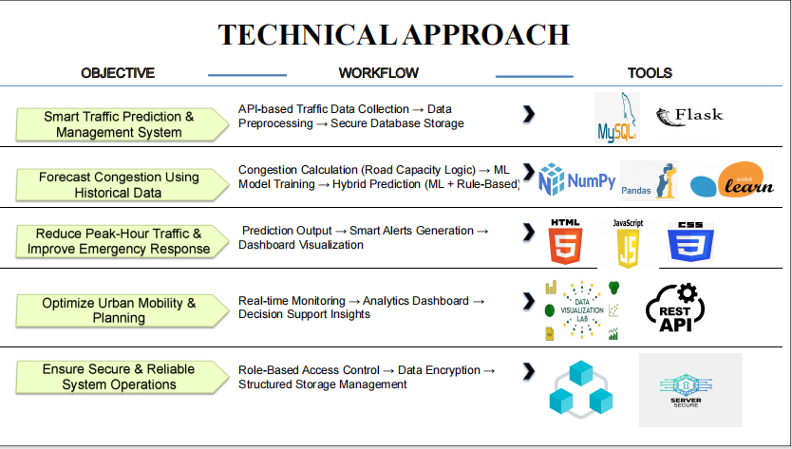

Slide 5
KEY BENIFITS:-
🚦 Faster traffic movement
⏱ Reduced waiting time at signals
⛽ Lower fuel consumption
🌍 Reduced air pollution
📈 Improved urban traffic planning
🤖 AI-driven smart decision making
KEY IMPACTS:-
🚗 Reduces traffic congestion and travel time
⛽ Decreases fuel consumption
🌱 Lowers air pollution and carbon emissions
📊 Improves traffic management efficiency
💼 Minimizes economic productivity loss

Slide 6
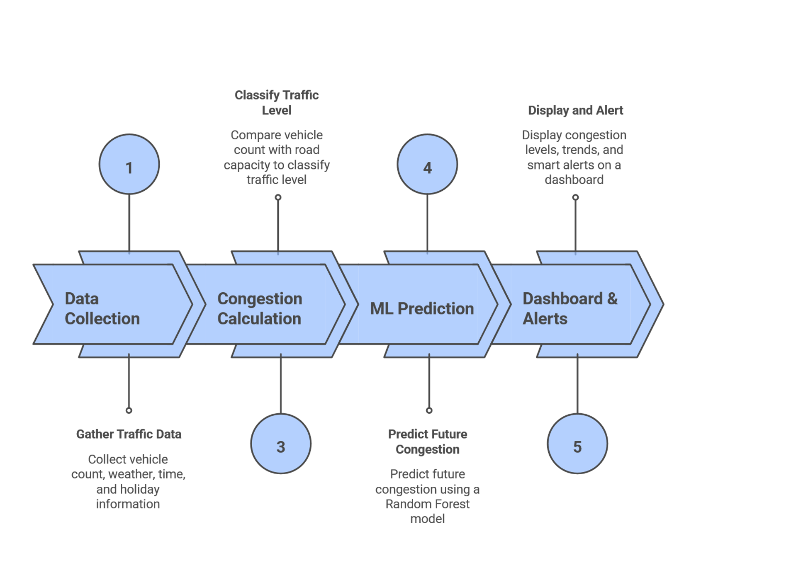
Traffic Congestion Prediction Workflow

Slide 7

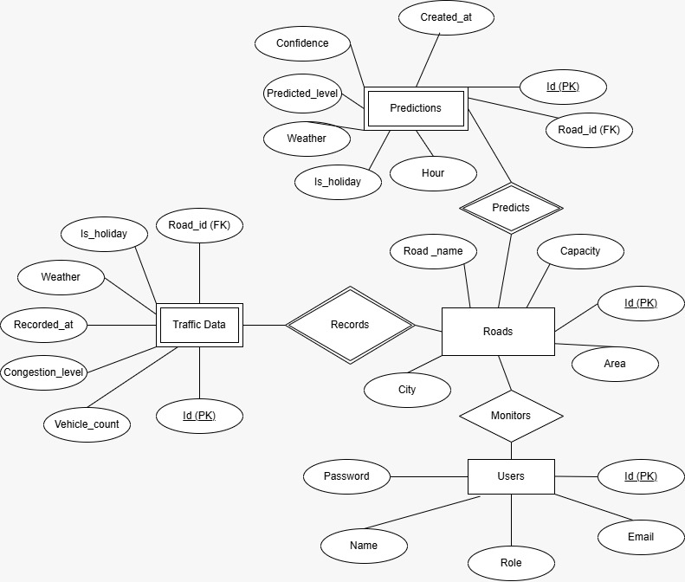

ER-DIAGRAM:-
Feasibility
Built using lightweight technologies (Python, Flask, MySQL)
Runs on standard hardware (no high-end setup needed)
Compatible with existing traffic data sources (manual, sensors, CCTV)
ML model improves using historical data
🚀 Scalability
Add new roads via database updates
Optimized with indexing for better performance
Modular REST API supports easy expansion
Cloud-ready for city-wide deployment

Slide 8
THANKYOU

